Slide 1


Setting up your LinkedIn
Brigham Young University – Idaho

Slide 2

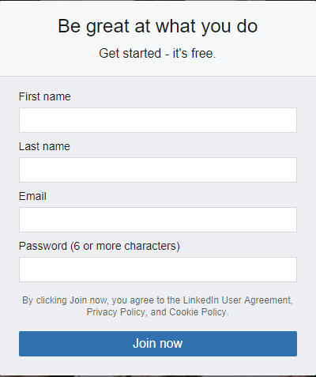
Create an account
Required information for creating an account:
First Name
Last Name
Email
Password

Slide 3
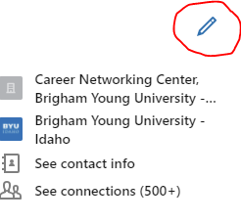
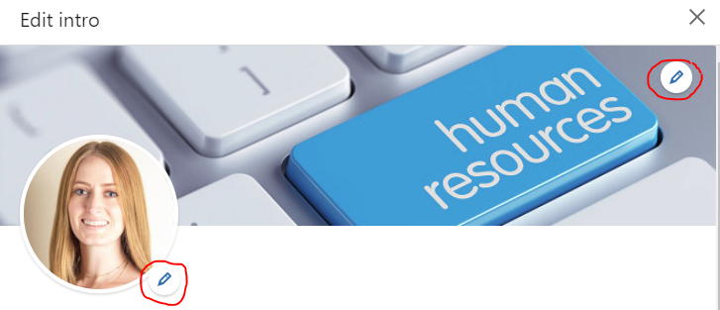
How to edit your profile
When viewing your profile (on the right side of your name) it lists your job, school, contact info and number of connections click on the pencil.
The pencil takes you to a popup called “Edit Intro” this is where you can edit your profile information.
Once you are on the “Edit Intro” popup, click on the pencil near the profile picture to edit the profile picture and the same thing for the background picture.
(Details on profile pictures and background pictures are on the next slides)

Slide 4
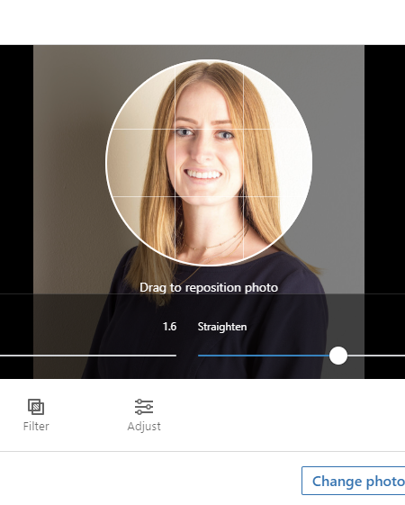

Upload a Profile Picture
To edit or change your profile picture, click on the space where your profile picture will be located and click “Change Photo”
Go to the Alumni Office to get a professional picture taken for free!
Dress professionally
Do not use: wedding pictures, family pictures, selfies, etc.
Your face should take up 50% of the space
KEEP IT PROFESSIONAL

Slide 5

Upload a background picture
Don’t keep the default background picture. By uploading your own, it shows you put more effort into your account
Your background should relate to the field you are interested in
When searching for a picture do the following: Google Images > “Settings” > “Advanced search” > change the usage rights (more info on next slide)

Slide 6
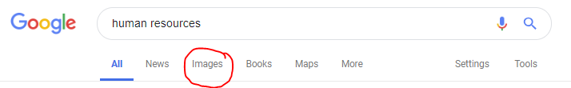

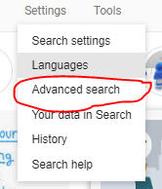

Use copyright-free background pictures
You can use your own picture for your background picture (even a picture of you in action in your profession)
If you do not have a picture you have taken, please follow these steps for copyright reasons.

Slide 7
Edit url
Edit your URL by removing the random numbers and letters at the end of the URL
By customizing your URL it makes it look more professional when sharing it
(Ex. on a resume)
When LinkedIn users edit their URL it shows that they put more effort into their appearance on LinkedIn
Example:
www.linkedin.com/in/yourname
Note: If the URL you produce is already in use try putting an underscore between your first and last name

Slide 8
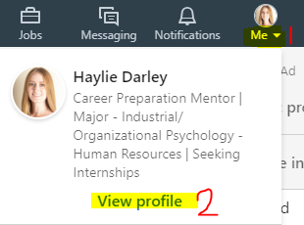

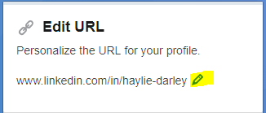
Editing your url
When viewing your profile there will be an option on the top right, “Edit public profile & URL”
Click on “Edit public profile & URL”
On the top right where it states, “Edit URL” click on the pencil next to your URL and edit your URL

Slide 9
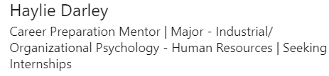

Attract recruiters w/a powerful heading
Items you can put in your heading:
Current position
Major and minor
What you are aspiring to be
What you are seeking from LinkedIn
Separate each item with a symbol that divides the information: “|”, “*”, “/”, etc.
Customer Care Specialist // Workforce Psychology// Seeking Connections
Do not list the university you are attending in your heading
When companies/ recruiters search they see the heading and you want them to learn more about you than just the school you attend
You are limited to 120 characters, so you need to keep it short and to the point

Slide 10
Writing an engaging summary (structure)
Write short paragraphs to keep the audience's attention
Write in the first person: “I”, “Me”, etc.
In your summary, you can add a specialties section. This is where you can state your hard skills and/or technical skills
Add your email address, so professionals that are not connected with you can easily contact you
Add any URL’s that are hyperlinked (Portfolium) that demonstrates your work/ success. If it does not add value/ make you stand out it is not needed

Slide 11
Engaging Summary Continued
You can approach the summary section in many ways depending on what you are wanting to get out of LinkedIn
Share your personal philosophy
Highlight your accomplishments, skills, experiences, etc.
Demonstrate your leadership style or experiences
Share your values, goals, interests, etc.
Demonstrate your knowledge of the field you are going into
Most importantly, SHARE and DEMONSTRATE your passion for the field you are seeking!

Slide 12
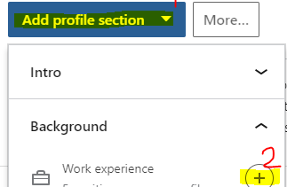
experience
The “Experience” section should include all your significant work experience
To add work experience click “Add profile section”, click “Background” and then click the plus sign “+” next to “Work Experience”
Complete all the required information to add the experience
Title
Company
Dates
Headline
Description
In the “Description” box copy and paste your bullet points from your resume to LinkedIn
NOTE: Your work experience on your LinkedIn account should match your resume

Slide 13
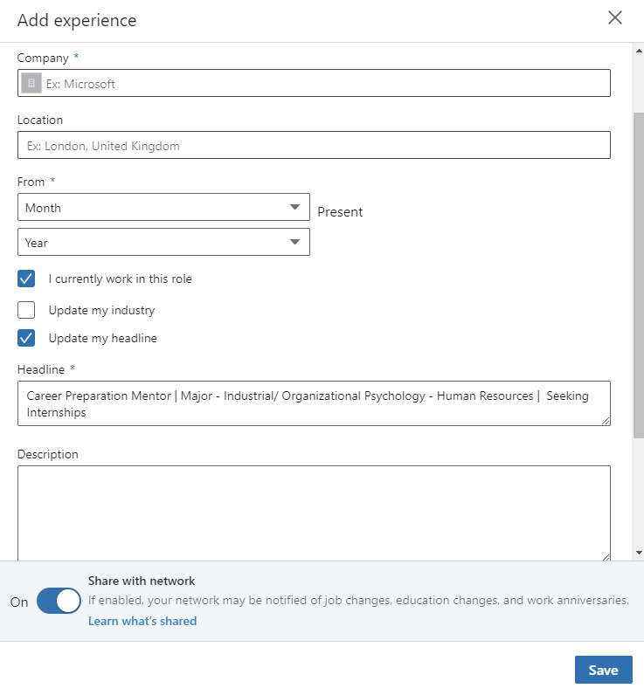

Slide 14
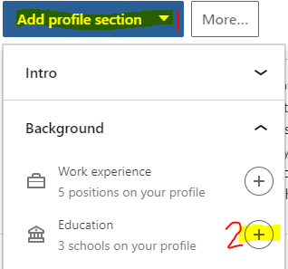
Education
List all your higher education
Do not list your high school unless you are a Freshman
To add education click “Add profile section”, click “Background” and then click the plus sign “+” next to Education
Complete all the required information to add education
School name
Degree
Time frame

Slide 15
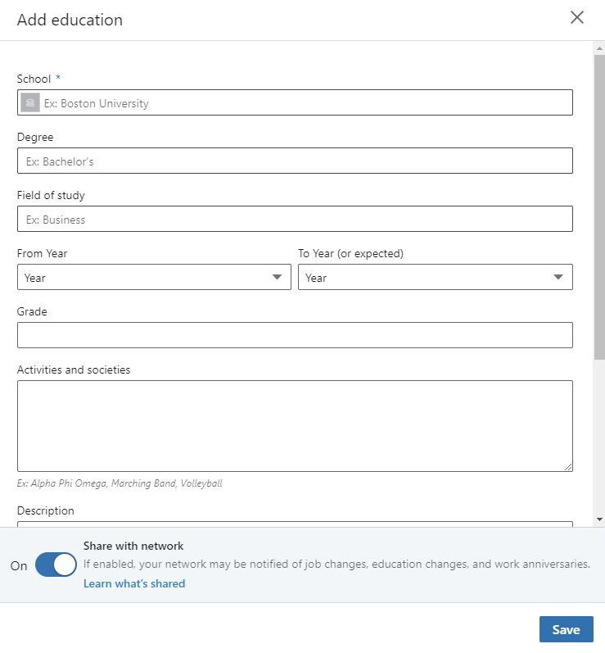

Slide 16
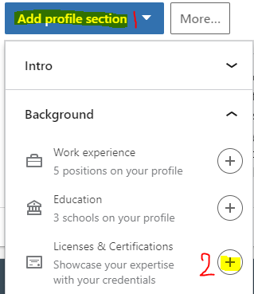
Licenses and certificates
List any licenses and certificates you received that is relevant
To add licenses and certificates click “Add profile section”, click “Background” and then click the plus sign “+” next to Licenses and Certificates
Complete all the required information to add any licenses and/ or certificates
Name of license or certificate
Issuing Organization
Dates
If applicable credential ID and/or URL

Slide 17
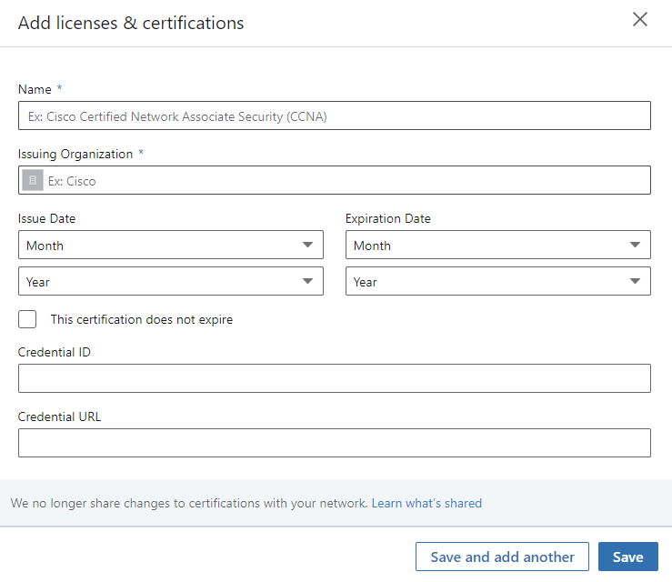

Slide 18
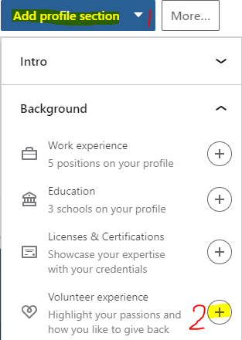
Volunteer experience
The “Volunteer Experience” section should include all of your significant volunteer experience
To add volunteer experience click “Add profile section”, click “Background” and then click the plus sign “+” next to “Volunteer Experience”
Complete all the required information to add volunteer experience
Organization
Role
Cause
Dates
In the “Description” box copy and paste your bullet points from your resume to LinkedIn
NOTE: Your volunteer experience on your LinkedIn account should match your resume

Slide 19
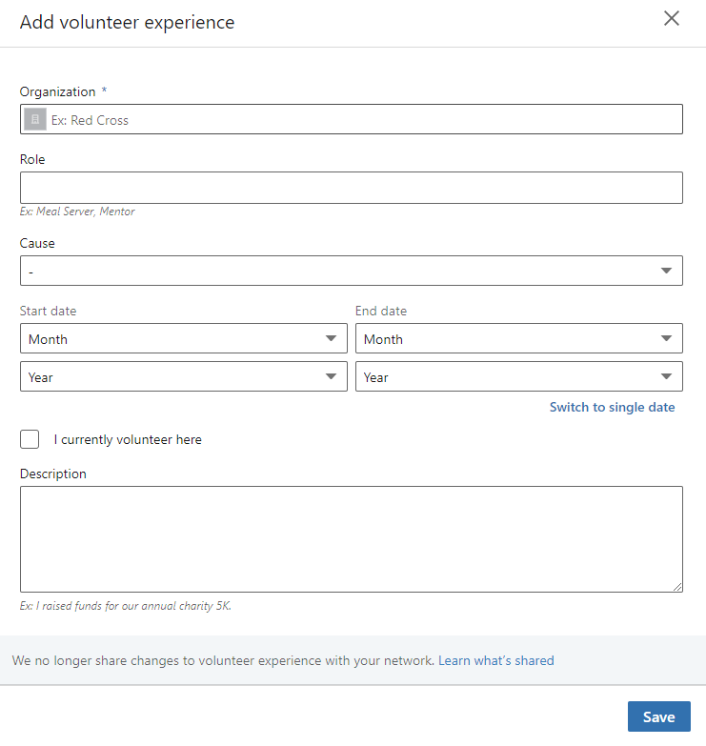

Slide 20
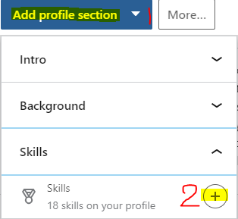
skills
List all the skills that you want professionals to know about
Keep in mind of skills that are applicable to the field you are going into
To add skills click “Add profile section”, click “Skills” and then click the plus sign “+” next to “Skills”

Slide 21
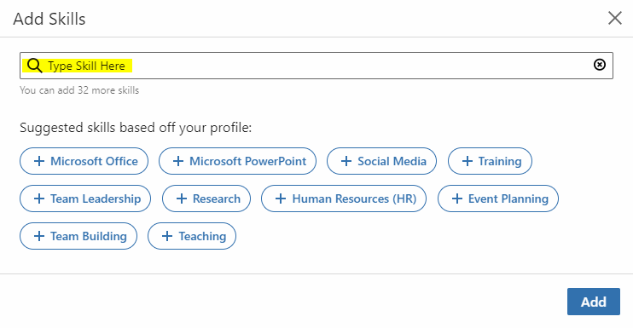

Slide 22
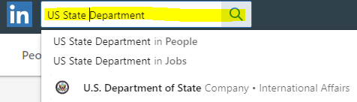
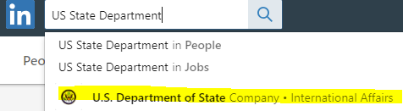
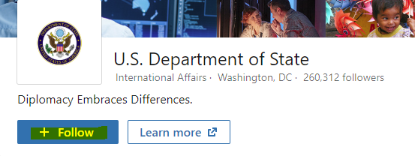
Interests
Follow companies that you are interested in
By following the companies you are interested in you will receive all their posts on your newsfeed
Steps to follow a company
Search a company in the search engine
Click on the company
Click Follow

Slide 23
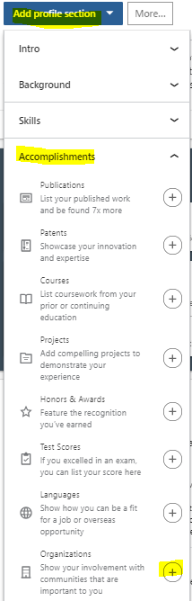
Organizations
Include any organizations/ associations, societies and clubs you are involved in
There are a lot of organizations that relate to the field's students are studying
If you are not involved in any, you do not need to add anything in this section
To add organizations click “Add profile section”, click “Accomplishments” and then click the plus sign “+” next to “Organizations”
When completing the form to add an organization, in the description box use bullet points to demonstrate what you did

Slide 24
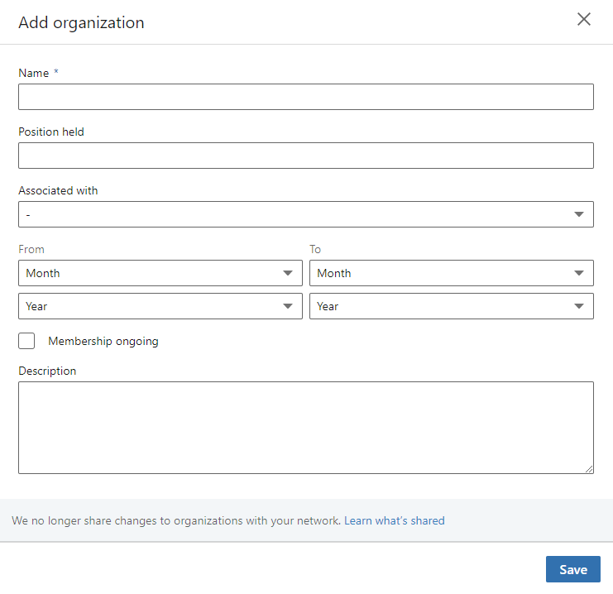

Slide 25

Honors and awards
This is where LinkedIn users share their honors and awards that they believe are relevant for other professionals to be aware of
If you do not have anything that falls under this category, you do not need to add anything
To add Honors and Awards click “Add profile section”, click “Accomplishments” and then click the plus sign “+” next to “Honors & Awards”
Complete all the required information to add the Honor/ Award
Title
Associated with
Issuer
Date

Slide 26
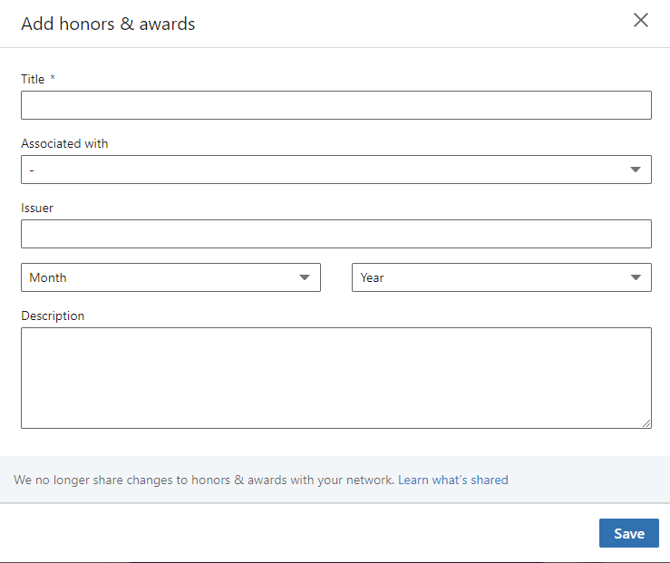

Slide 27
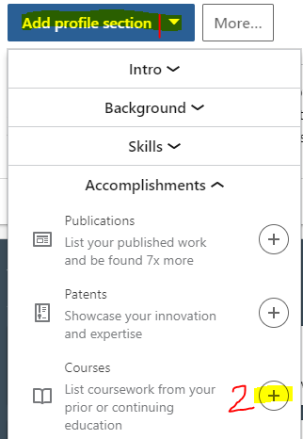
Courses
Add courses to your profile to demonstrate your knowledge
List the most important and relevant courses
This is a great section for undergraduates
To add courses click “Add profile section”, click “Accomplishments” and then click the plus sign “+” next to “Courses”
Complete all the required information to add a course
Course name
Course number
Associated with what school

Slide 28
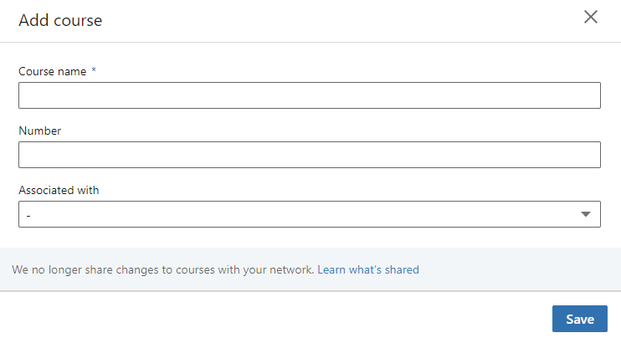

Slide 29
Recommendations
Recommendations validate who you are
Ask your co-workers, bosses, managers, friends, classmates, etc. to write you a recommendation
Recommendations from managers and bosses have a greater impact than a recommendation from a friend
It is advised that you have a recommendation for each position you have listed on your LinkedIn profile

Slide 30
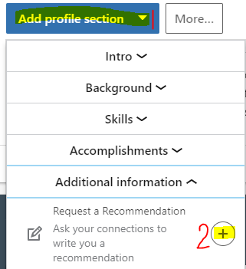
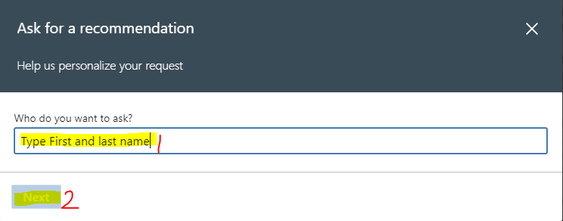
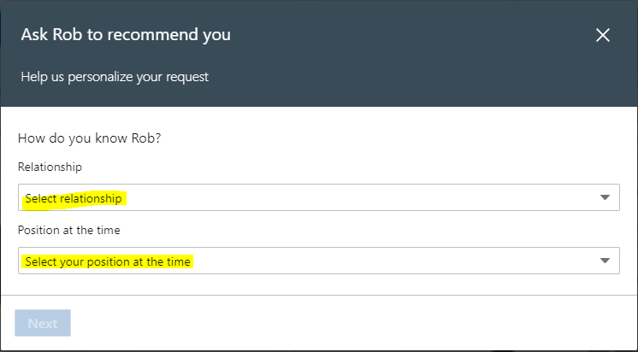
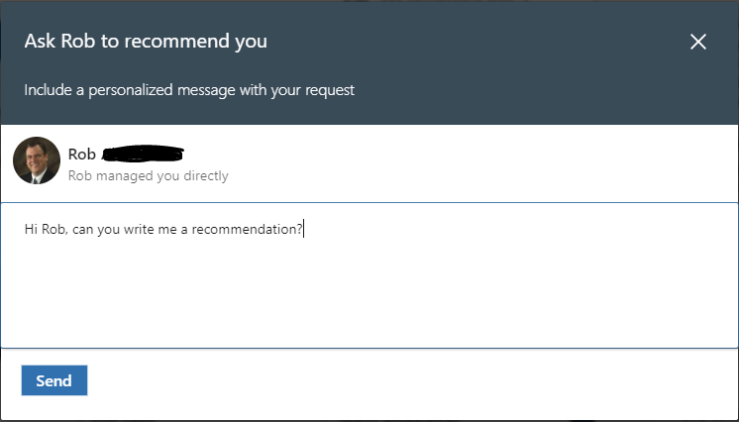
Requesting Recommendations from profile page
To request a recommendation from your profile page follow the steps listed below
To request a recommendation click “Add profile section”, click “Additional Information” and then click the plus sign “+” next to “Request a Recommendation”
Complete all the required information to request a recommendation
Name of the person you want to ask
Relationship with individual
Position you were working at the time of relationship
Write a personalized message asking for the recommendation

Slide 31
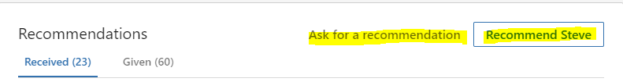
Requesting recommendations when viewing other profile pages
You can request a recommendation for yourself or write a recommendation for another person while reviewing an individual's profile page
When reviewing an individual’s profile page scroll to the bottom where it states “Recommendations”:
Click “Ask for a recommendation”
OR
Click “Recommend ____”

Slide 32

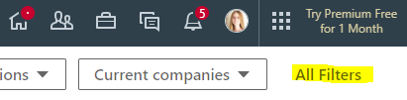
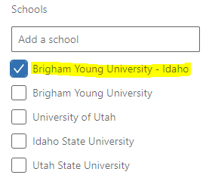
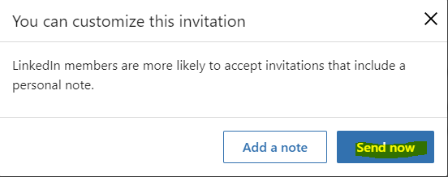
Connecting with peers
Once you have your profile set up, start connecting with your peers/ other students
To connect with other students
Click the search box and hit “Enter” on your keyboard
On the top right click “All Filters”
Scroll down to the “Schools” section and click “Brigham Young University – Idaho”
Click “Apply”
A list of individuals that attend BYU-Idaho will show up in the results. If they are just students click “Connect” and “Send Now”

Slide 33
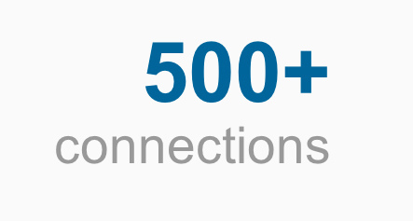
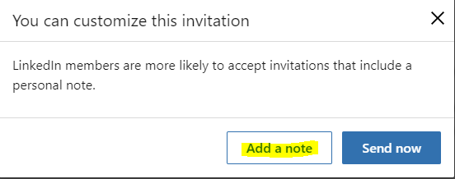
Connecting with professionals
Once you have 500+ connections start connecting with professionals
With 500 + connections it shows that you are actively using LinkedIn and you will be bumped up in search results
When connecting with a professional (not a student, co-worker, etc.) add a note (message) when connecting with them
It is LinkedIn etiquette to send a note when connecting with an individual that is not a peer

Slide 34
“Note” example when asking to connect
Here is an example of how to leave a note with a professional. Keep in mind, there are many of ways to write a note. You are not limited to this example:
“Hello Jake,
My name is John Doe and I am currently attending Brigham Young University – Idaho majoring in Business Supply Chain. I noticed that you are a Supply Chain Manager at ABC Fake Company. Would you like to connect?
Have a great day,
-John Doe”

Slide 35
Leaving a note when a professional connects with you!
Once you complete your profile and start connecting with people, you will not always be the person initiating a connection
It is true! Professionals will ask to connect with you!
When a professional asks to connect with you and if you are interested, accept their request. Don’t just accept it and leave it at that… WRITE THEM A MESSAGE!

Slide 36
Writing a message after accepting a professional's request
Here are examples of how to write a message after accepting a professional’s request. Again, there are many of ways to write this message and you are not limited to this example:
EXAMPLE 1
“Hello Robert,
I just wanted to thank you for connecting with me. I noticed that you recently started
working for ABC Fake Company in their Human Resources Department. If you have some time,
I would love to ask you some questions about your new role.
Have a great day,
Harry Hatter”
EXAMPLE 2
“Hello Victor,
Thank you for connecting with me! I noticed on your profile that you know ASL. I also know ASL, how did you learn the language?
-Jeri Jones”

Slide 37
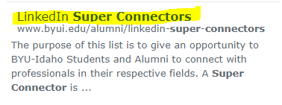
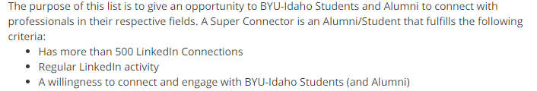
Expanding your linkedin network
There are a few ways to expand your network:
Connect with BYU-Idaho’s super connectors
To find the super connectors go to BYU-Idaho’s homepage and search “LinkedIn Super Connectors”
Click on the first option “LinkedIn Super Connectors”
Review the webpage and find the super connectors you want to connect with then go to LinkedIn and connect with them

Slide 38


Expanding your linkedin network
Follow associations and groups that are relevant to the field you are going into
Research associations/ organizations on your own
If you are familiar with any, search for them on LinkedIn and follow them

Slide 39

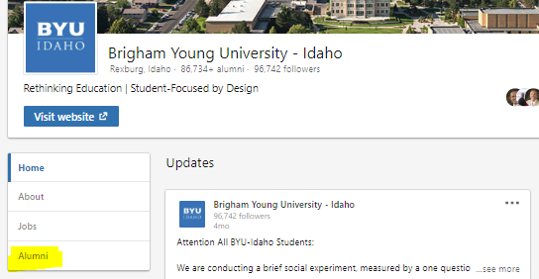
Searching alumni
There are so many alumni from BYU-Idaho that want to help current students find jobs and internships
To find alumni on LinkedIn:
Search “Brigham Young University – Idaho”
Click on “Alumni”
When reviewing the alumni, you can search by location, where they work, etc.

Slide 40


Job searching
On the top of the LinkedIn webpage, click on the icon that looks like a briefcase.
Search the position or general role you are looking for and the location
Users can do can advanced search;
Date Posted: change how old the post can be
LinkedIn Features: can click “Easy Apply”, “In Your Network”, or “Under 10 Applicants”
Company: search by specific companies
Experience Level: filter by “Internships”, “Entry level”, etc.

Slide 41

Job searching
When searching for a job there are two ways to apply:
Apply through LinkedIn “Easy Apply”
Apply through the company's website “Apply”
NOTE:
If you apply for a job using the “Easy Apply” feature, also go to the company's website and apply through their application process.
Since the “Easy Apply” is so easy and convenient you will come off as more interested in the job if you apply through LinkedIn and on their webpage.
When you find a job positing you are interested in, the apply button will inform you if you apply through LinkedIn or on the company website.
Applying through company website
Applying through LinkedIn

